Slide 1
Monitoring Your Energy Bills

Slide 2
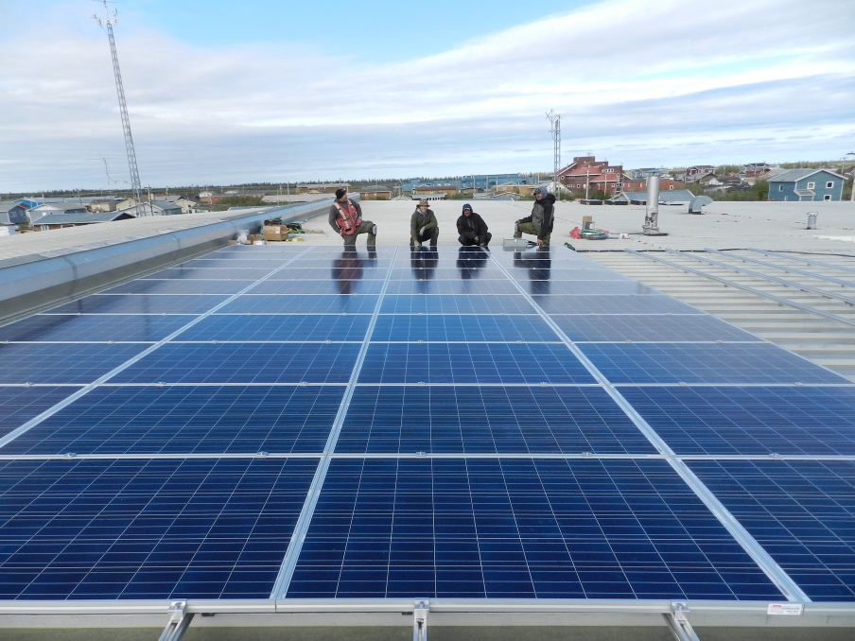
Who We Are: Arctic Energy Alliance
Not-for-profit organization
Mission: “To lead and facilitate the integration of efficient, renewable and sustainable energy practices in the NWT”
Six offices across the NWT

Slide 3
What we are covering
Energy sources in your home
Reading fuel, electricity, and water bills
How to track bills and better understand your energy use

Slide 4
Energy Sources in Your Home

Slide 5
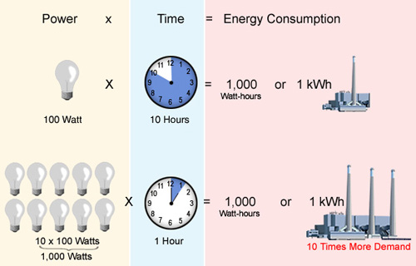
Energy Sources in Your Home
Electricity
  kW and kWh
  Hydro, diesel electricity
Fuel
  Oil, propane, pellets, wood
  Litres or m³
Water
MJ or GJ (as units of measurement)
Notes:
kW: measure of power (what a device uses)
kWh: measure of energy (what it uses over time)
Explain MJ and GJ
1GJ of energy is about 2 BBQ propane tanks
277.78 kWh is 1GJ

Slide 6
Fuel Bills

Slide 7
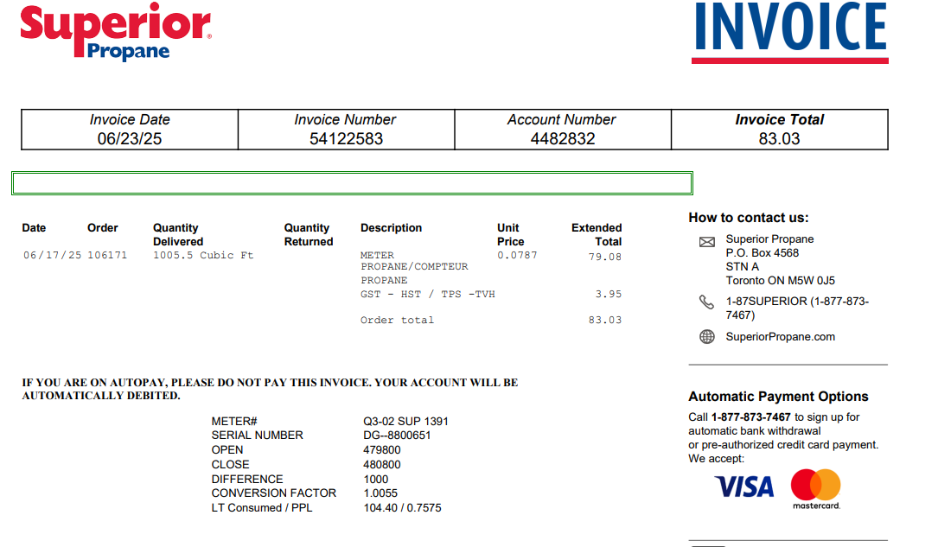
Fuel Bills Exercise
Fuel type(s)
Delivery date
Duration since the last delivery
Fuel quantity delivered
Notes:
Heating values, different fuel types, and different efficiency of common combustion appliances

Slide 8
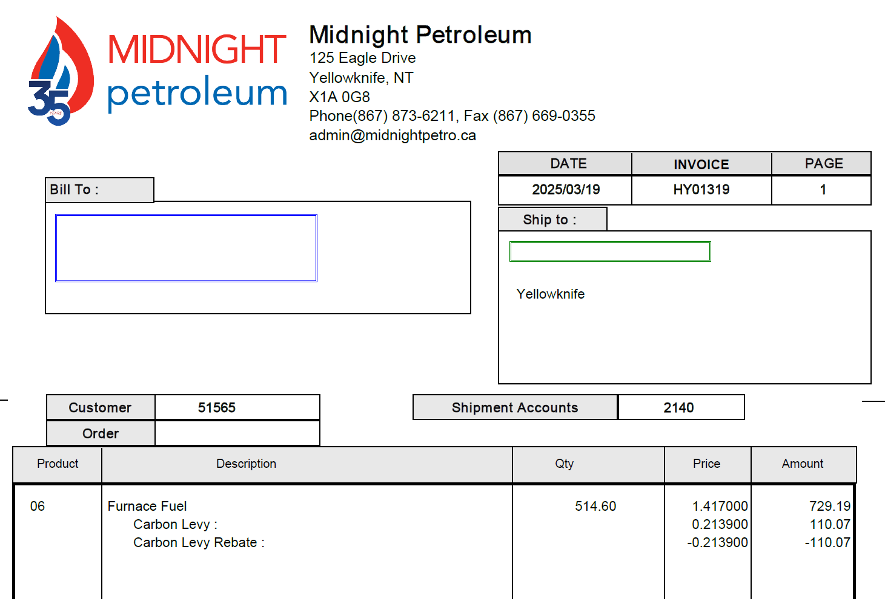
Fuel Bills Exercise
Fuel type(s)
Delivery date
Duration since the last delivery
Fuel quantity delivered
Notes:
Heating values, different fuel types, and different efficiency of common combustion appliances

Slide 9
Fuel Bill Tracking
What trends do we see?

Slide 10
Fuel Bill Tracking
What trends do we see?
Notes:
This is a newer chart based on Taylor’s Bills. Combi-boiler hot water system.

Slide 11
Fuel Bills Exercise
Annual fuel usage in Yellowknife:
2000 ft² house ~ 125 GJ/year
Water heating ~ 21 GJ/year
 | Average home in Yellowknife
Oil | 3300 L
Pellets | 7000 kg or 7 pallets
Propane | 4700 L
Wood | 7 cords

Slide 12
Fuel Bills Exercise
It’s important to track your fuel use
  Call your fuel provider for info on past bills
  Visit their website to access past bills
Weather plays a role in fuel use

Slide 13
Fuel Bills Exercise
Some fuel saving measures:
  Weather stripping
  Plastic on windows
  Air sealing
  Programmable thermostats/setbacks
  Change in habits
  Upgrading heating appliances

Slide 14
Electricity Bills

Slide 15
How to Read Your Electricity Bills
Current cost in Yellowknife
  $18.00 base charge
  $0.2372/kWh energy charge
  $0.1032/kWh purchase power cost adjustment rider F
  -0.0878% Cost Recovery/Refund rider H
  $0.0074 Global Rate Adjustment rider G
  4.999% rate adjustment rider R
  2.464% franchise tax
  5% GST
  ~$0.38/kWh + base charge + GST
  *As of February 2026
Notes:
Bring your own bills
Naka Power (Utilities) | Rates & Regulations
https://www.nakapower.com/en-ca/customer-billing-rates/rates-regulations.html
Fuel Cost Library
Rider H ends May 1
Rider G ends June 1
Rider E is used to either refund money to customers or collect extra costs when past rates didn’t match actual expenses.
Rider F adjusts your bill to reflect the real cost of purchasing wholesale power from NTPC in Hydro communities within the Snare Rate Zone.
Rider G helps recover costs related to the transition of Hay River’s electricity services from Naka Power Utilities to NTPC.
Rider H is used to either collect or refund money based on certain costs approved by the regulator.
Rider R adjusts your bill during and after the General Rate Application (GRA) process—this is when the regulator reviews and approves new electricity rates.
The Franchise Tax collects the fee that the utility pays to the City of Yellowknife for the right to operate within city limits.

Slide 16
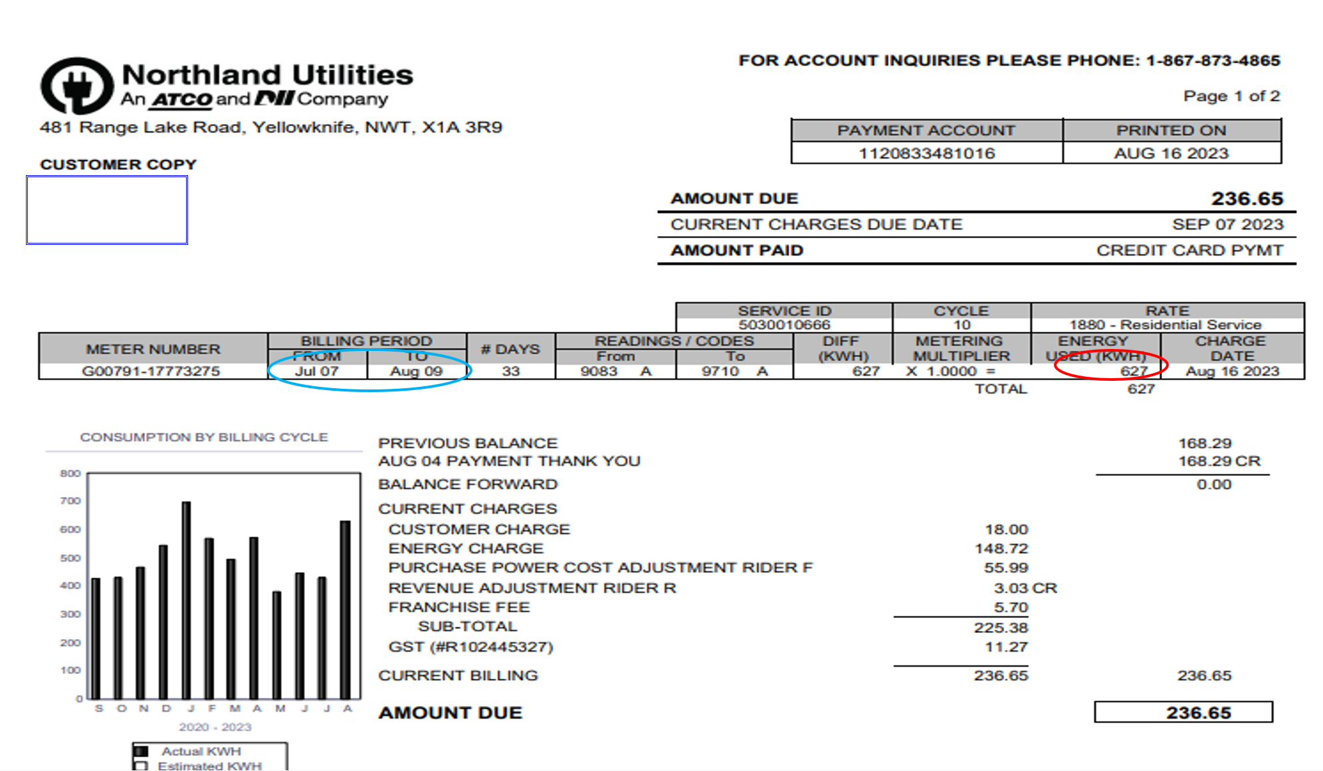
Metered date
Duration since the last metered date
kWh
$/kWh and riders

Slide 17
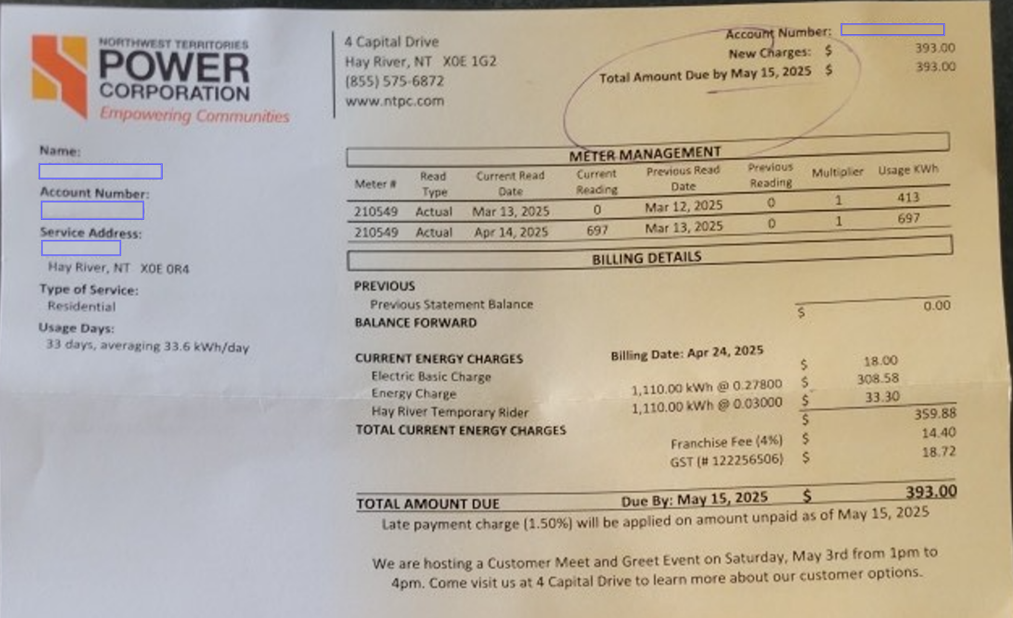
Metered date
Duration since the last metered date
kWh
$/kWh and riders

Slide 18
Electricity Bills Exercise
What trends can we identify?
Notes:
From the old document, think it is electric hot water hence why so high

Slide 19
Electricity Bills Exercise
What trends can we identify?

Slide 20
Electricity Bills Exercise
Standard assumptions for a typical house:
6.3 kWh/day for electric appliances
2.6 kWh/day for lighting
9.7 kWh/day other electricity use
.9 kWh/day exterior use
585 kWh/month or ~7120 kWh/year
Electric hot water in addition is 480 kWh/month or ~5,800 kWh/year
Notes:
1000 kWh in winter limit, 600 kWh in summer

Slide 21
Electricity Bills Exercise
It’s important to track your electricity use
  Look on your online account for past bills
  Call your electricity provider for info on past bills
Occupancy and behaviors play a role in electricity use
Notes:
Ask participants what electricity-savings measures they recommend/are using?
Gadgets are not going to save you electricity (actually uses elec).
Killawatt meter rental/sign out sheet if participants are interested

Slide 22
Electricity Bills Exercise
Some electricity saving measures:
  Use timers
  Install more efficient lighting
  Install more efficient systems
  Turn off unused appliances
Notes:
Ask participants what electricity-savings measures they recommend/are using?
Gadgets are not going to save you electricity (actually use elec).

Slide 23
Electricity Bills Exercise
Electricity monitoring devices:
  Blueline
  eMonitor
  Kill-a-Watt
Kill-a-Watt meters available at library in Yellowknife
Notes:
Log in to Mike’s emonitor site and show case low electricity use.
Killawatt meter rental/sign out sheet if participants are interested
Moving this to a later section -TA

Slide 24
Water Bills

Slide 25
How to Read Your Water Bills
Metered date vs. billing date
Duration since the last metered date
Litre or m³
$/litre or $/m³
Notes:
Adjustment quarterly, usually estimated amount

Slide 26
How to Read Your Water Bills
Fee | Description | Total Cost
ACCESS FEE | To access the city’s water lines | $10.00
DEMAND CHARGE | Based on the size of meter providing water | $12.50
SOLID WASTE LEVY | Compost and garbage disposal | $29.75
INFRASTRUCTURE LEVY | Covers the cost associated with water and sewage upgrades | $18.50
INSURANCE PROGRAM | This insurance covers the line between the city’s water line and the consumer. | $12.50
CONSUMPTION | Based on water usage during the month | $4.50 per m³
TOTAL | Sometimes this is computer estimated
Notes:
Adjustment quarterly, usually estimated amount
Insurance program: All costs associated with residential water line repair on the homeowner’s side is subject to a $1000 deductible.

Slide 27
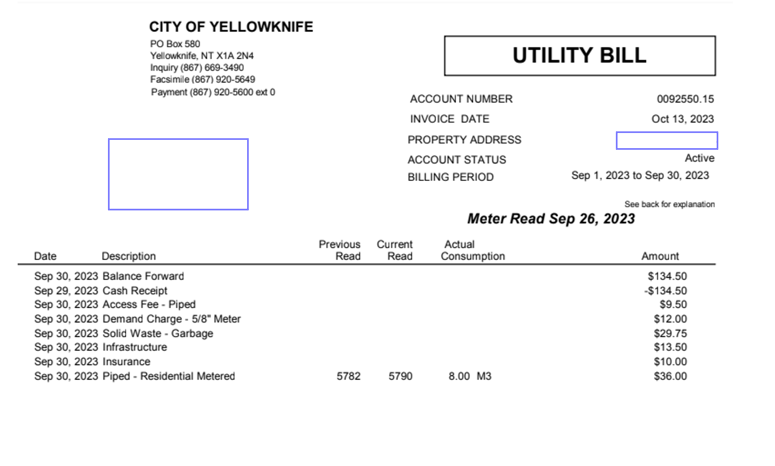
Water Bills Exercise
Metered date vs. billing date
Duration since the last metered date
Litre or m³
$/litre or $/m³
Notes:
Truck water delivery – clean your tank every year

Slide 28
Water Bills Exercise
Negative water use? How?
Not a smooth line due to the nature of the readings
Notes:
The answer is actual vs estimated consumption

Slide 29
Water Bills Exercise
Average residential usage in NWT:
~204L/capita/day or 6m³/person/month
Notes:
https://www150.statcan.gc.ca/n1/daily-quotidien/231114/cg-d002-png-eng.htm

Slide 30
Water Bills Exercise
It’s important to track your water use
  Check your online account for past bills
  Call the City of Yellowknife for info on past bills
Saving water saves on heating fuel/electricity as well!
Notes:
Home water use from NRCan,

Slide 31
Water Bills Exercise
Some water saving measures:
  Low-flow/dual-flow toilets
  Low-flow showerheads
  Fix leaky faucets
  Food coloring to check leaking toilets
  ENERGY STAR Front-load washer
  ENERGY STAR certified dishwasher
Notes:
Low flow is 6 litres or less

Slide 32
Tracking Your Bills

Slide 33
How to Use the Take-Home Template to Analyze Your Bills
Input your energy bills in the yellow cells, check the ‘Graph’ tab for plots.

Slide 34
Diagnosing Issues
Looking for outliers
Estimated vs Actual consumption
Dates being billed

Slide 35
Diagnosing Issues
Space heaters and vehicle plug-ins use a lot of power
Leaking plumbing or faucets can consume a lot of water
Use a Kill-a-Watt meter to determine how much power something uses

Slide 36
Fuel Cost Library
AEA publishes a Fuel Cost Library each year
Gives an average of the cost of each fuel in each community
https://aea.nt.ca/document/6075/?tmstv=1755553420

Slide 37
Diagnosing Issues
Reach out to us for help figuring out what is happening
  867-920-3333
  info@aea.nt.ca

Slide 38
Summary
Understanding different energy sources
Understanding the value of tracking bills
How to track your bills effectively (contact utilities)
AEA’s free advice, rebate programs (AETP and EEIP), home energy evaluations

Slide 39
Thank you
Mahsi
Questions?
Notes:
Discussion.

